Slide 1
Monitoramento de Tráfego
Boonsong Lekagul Nature Preserve

Slide 2
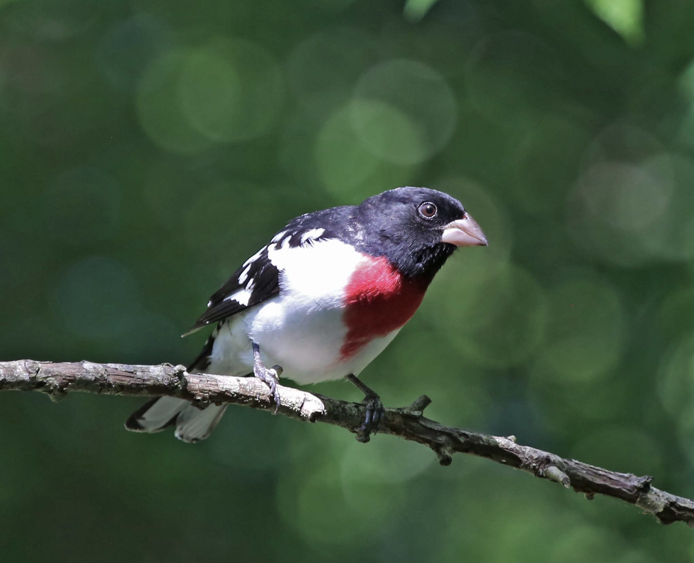

Slide 3
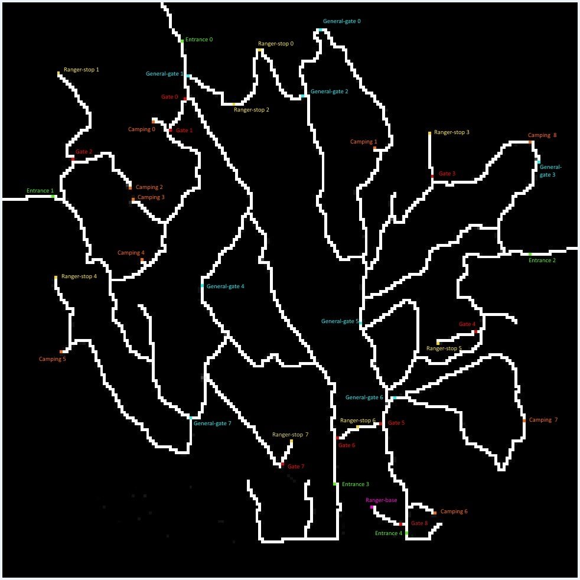

Slide 4
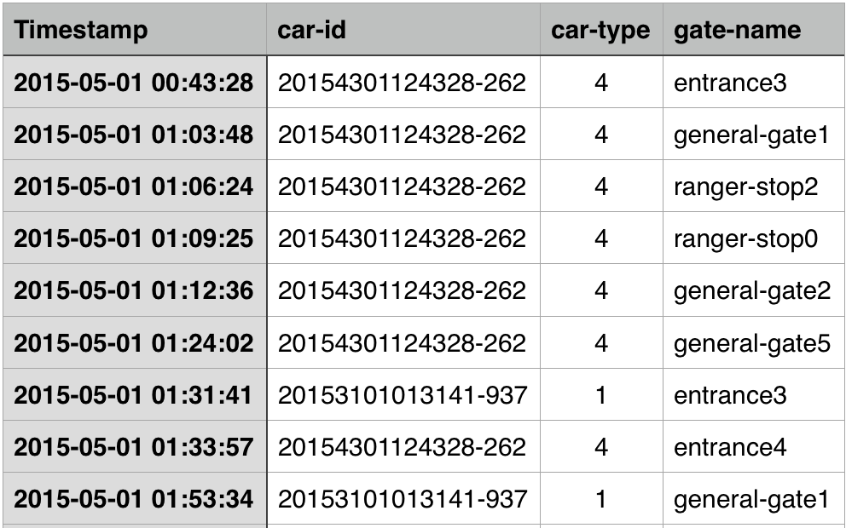
Notes:
Describe up to six daily patterns of life by vehicles traveling through and within the park. Characterize the patterns by describing the kinds of vehicles participating, their spatial activities (where do they go?), their temporal activities (when does the pattern happen?), and provide a hypothesis of what the pattern represents

Slide 5
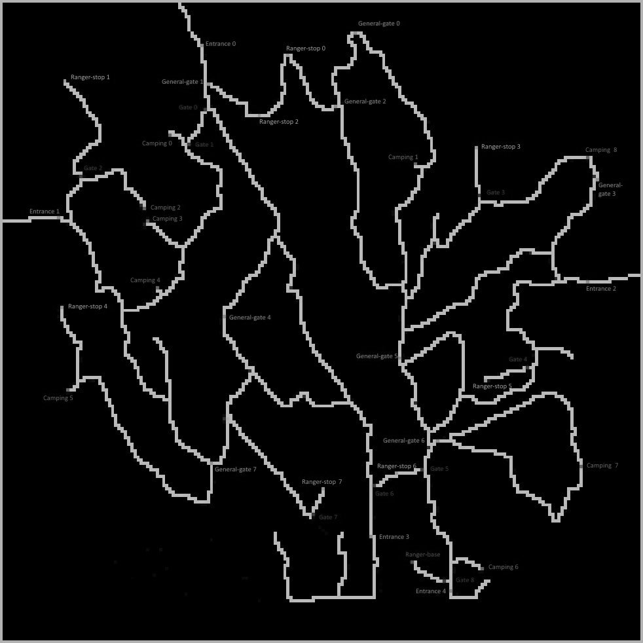
Padrões Diários
Padrões Temporais
Padrões Atípicos

Slide 6
Padrões Diários
Padrões Temporais
Padrões Atípicos

Slide 7
Padrões Diários
Padrões Temporais
Padrões Atípicos

Slide 8
Quem?
Quando?
Onde?

Slide 9
Obrigado!

